Slide 1


KS4 Mathematics
A9 Graphs of important non linear functions

Slide 2
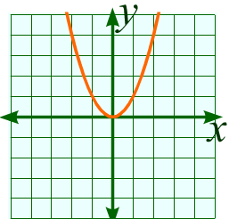
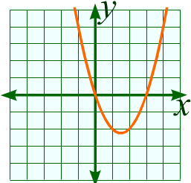
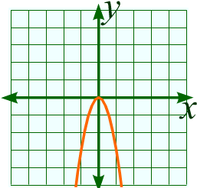

Quadratic functions
A quadratic function always contains a term in x². It can also contain terms in x or a constant.
Here are examples of three quadratic functions:
y = x²
y = x² – 3x
y = –3x²
The characteristic shape of a quadratic function is called a parabola.
Notes:
Draw pupils attention to the characteristic shape of each of these quadratic functions and to the fact that they are symmetrical.

Slide 3
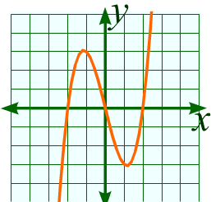
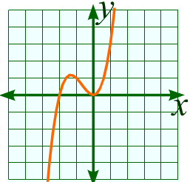
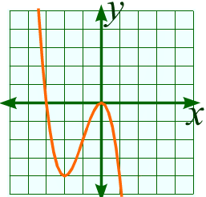
Cubic functions
A cubic function always contains a term in x³. It can also contain terms in x² or x or a constant.
Here are examples of three cubic functions:
y = x³ – 4x
y = x³ + 2x²
y = -3x² – x³
Notes:
Draw pupils’ attention to the characteristic shape of each of these cubic functions and to the fact that they have rotational symmetry of order 2.

Slide 4
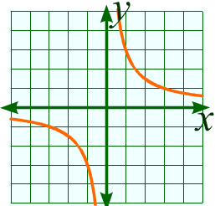
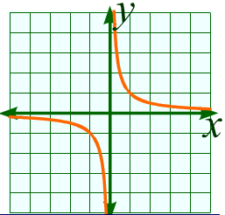
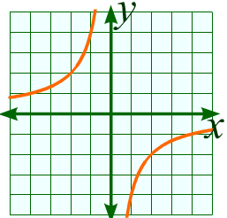
The reciprocal function
A reciprocal function always contains a fraction with a term in x in the denominator.
Here are examples of three simple reciprocal functions:
3
1
–4
y =
y =
y =
x
x
x
In each of these examples the axes form asymptotes. The curve never touches these lines.
Notes:
Draw pupils attention to the characteristic shape of each of these reciprocal functions and to the fact that they each has two asymptotes.
The shape of this graph is called a hyperbola.

Slide 5
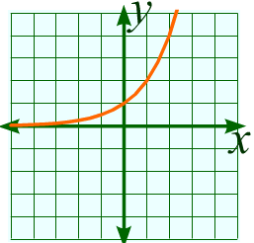
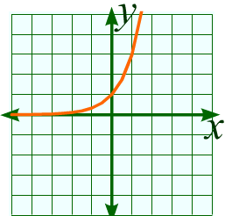
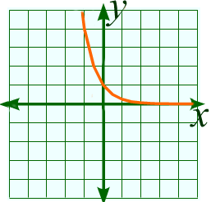
The exponential function
An exponential function is a function in the form y = a^{x}, where a is a positive constant.
Here are examples of three exponential functions:
y = 2^{x}
y = 3^{x}
y = 0.25^{x}
In each of these examples, the x-axis forms an asymptote.
Notes:
Tell pupils that exponent is another word for index.
Explain that these graphs are typical of of problems that involve repeated proportional change.

Slide 6
The equation of a circle
One more graph that you should recognize is the graph of a circle centred on the origin.
y
(x, y)
We can find the relationship between the x and y-coordinates on this graph using Pythagoras’ theorem.
r
y
0
x
Let’s call the radius of the circle r.
x
We can form a right angled triangle with length y, height x and radius r for any point on the circle.
Using Pythagoras’ theorem this gives us the equation of the circle as:
x² + y² = r²
Notes:
You may wish to explain that the equation of a circle is not a function, but a locus. This is because values of x do not map onto unique values of y. Each value of x between r and –r maps onto two values of y (except when x = ±r).

